Slide 1
summary(movie_language_aov)
Df Sum Sq Mean Sq F value Pr(>F)
language 42 150 3.580 2.979 0.000000000507 ***
Residuals 4524 5437 1.202
> movie_country_aov <- aov(imdb_score ~country,vote) # ANOVA vote_average on decade
> summary(movie_country_aov)
Df Sum Sq Mean Sq F value Pr(>F)
country 60 198 3.296 2.756 0.0000000000162 ***
Residuals 4506 5389 1.196
cv.test(vote$language,vote$country)
[1] Cramer V / Phi:
[1] 0.6379859
data: imdb_score and year
S = 18216000000, p-value < 0.00000000000000022
alternative hypothesis: true rho is not equal to 0
sample estimates:
rho
-0.1473695
cor(year,movie$decade)
[1] 0.9755298
cor(year,imdb_score)
[1] -0.2024579
> cor(movie$decade,imdb_score)
[1] -0.2008697
data: imdb_score and decade
S = 18413000000, p-value < 0.00000000000000022
alternative hypothesis: true rho is not equal to 0
sample estimates:
rho
-0.1597861

Slide 2
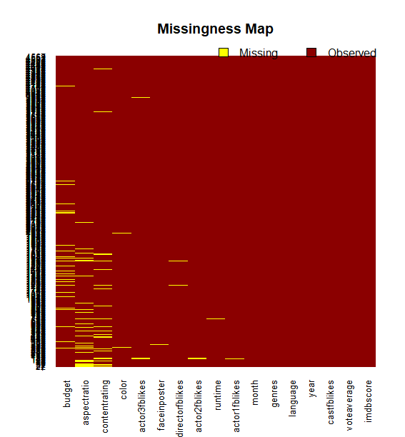
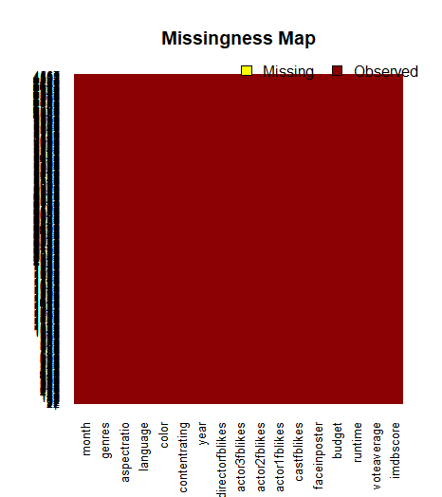
sum(is.na(movieana))] 795
sum(is.na(movieana$imdb_score))0
sum(is.na(movieana$vote_average))0
sum(is.na(movieana$runtime))6
sum(is.na(movieana$budget))270
sum(is.na(movieana$facenumber_in_poster))11
sum(is.na(movieana$cast_total_facebook_likes))0
sum(is.na(movieana$actor_1_facebook_likes))3
sum(is.na(movieana$actor_2_facebook_likes))6
sum(is.na(movieana$actor_3_facebook_likes))12
sum(is.na(movieana$director_facebook_likes))8
sum(is.na(movieana$year))0
sum(is.na(movieana$content_rating))204
sum(is.na(movieana$color))12
sum(is.na(movieana$language))0
sum(is.na(movieana$aspect_ratio))263
sum(is.na(movieana$genres))0
sum(is.na(movieana$month))0

Slide 3
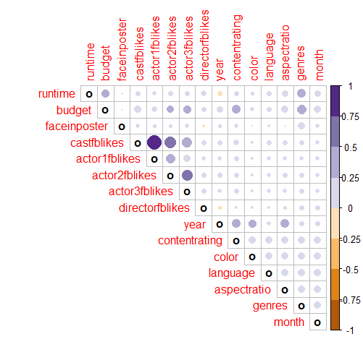
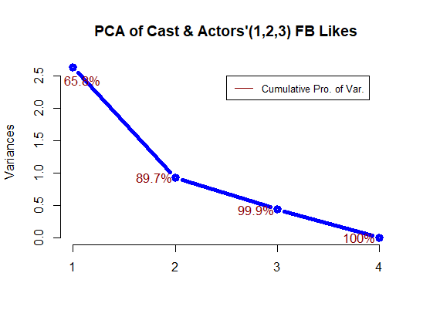
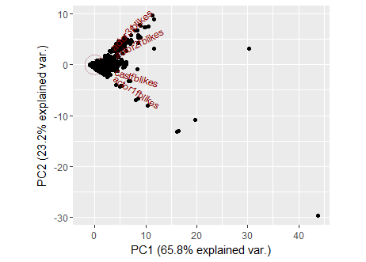
Importance of components:
PC1 PC2 PC3 PC4
Standard deviation 1.6226 0.9643 0.6601 0.04030
Proportion of Variance 0.6582 0.2325 0.1089 0.00041
Cumulative Proportion 0.6582 0.8907 0.9996 1.00000
sd(traindat$imdbscore)
[1] 1.103664
> mean(traindat$imdbscore)
[1] 6.428874
> sd(testdat$imdbscore)
[1] 1.129242
> mean(testdat$imdbscore)
[1] 6.385965
Standard deviations (1, .., p=4):
[1] 1.62257473 0.96433395 0.66006579 0.04030433
Rotation (n x k) = (4 x 4):
PC1 PC2 PC3 PC4
castfblikes 0.5915718 -0.2871048 -0.0497488 0.7517570
actor1fblikes 0.5145252 -0.5591687 -0.1632328 -0.6292450
actor2fblikes 0.4750651 0.4044386 0.7630342 -0.1688828
actor3fblikes 0.3995244 0.6643272 -0.6234252 -0.1019351

Slide 4
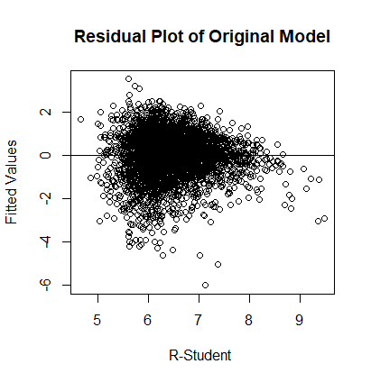
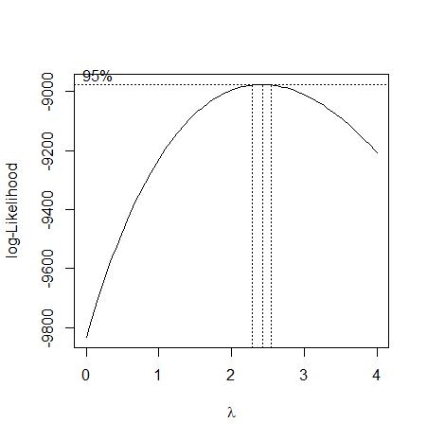
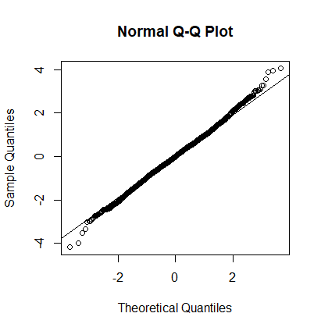
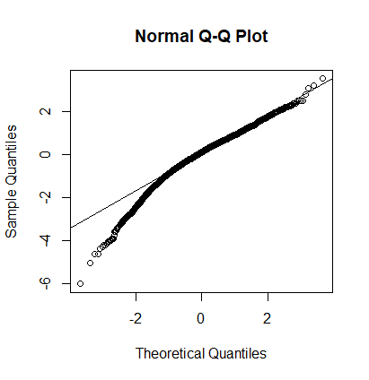
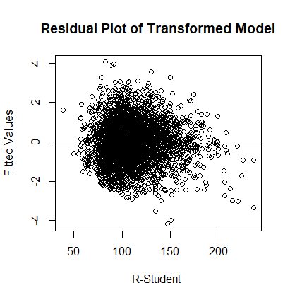
cor(predict(fit,testdat),testdat$imdbscore)
[1] 0.5046841
> sqrt(mean((predict(fit,testdat)-testdat$imdbscore)^2))
[1] 0.975809
cor(predict(fit,testdat)^(1/2.5),testdat$imdbscore)
[1] 0.5151224
> sqrt(mean((predict(fit,testdat)^(1/2.5)-testdat$imdbscore)^2))
[1] 0.9772535
GVIF Df GVIF^(1/(2*Df))
runtime 1.445893 1 1.202453
budget 1.848138 1 1.359462
faceinposter 1.099494 1 1.048567
directorfblikes 1.080606 1 1.039522
year 1.534931 1 1.238923
contentrating 2.046895 5 1.074260
color 1.161563 1 1.077758
language 1.204857 7 1.013401
aspectratio 1.453492 2 1.098002
genres 2.584543 15 1.032158
month 1.300300 11 1.012008
pc1castfb 1.161903 1 1.077916
pc2castfb 1.032810 1 1.016273
sequel 1.060749 2 1.014853

Slide 5
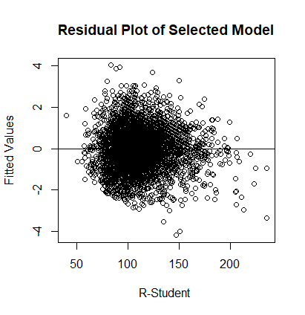

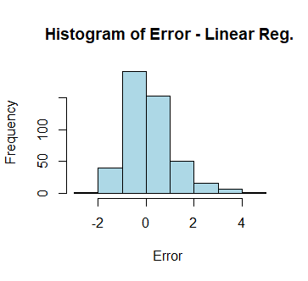
> summary(fit)
Call:
lm(formula = imdbscore^2.5 ~ runtime + budget + faceinposter +
directorfblikes + year + contentrating + color + language +
genres + month + pc1castfb + sequel, data = traindat)
Residuals:
Min 1Q Median 3Q Max
-143.892 -22.399 0.035 22.171 139.962
Coefficients:
Estimate Std. Error t value Pr(>|t|)
(Intercept) 1285.5835570 105.3750284 12.200 < 0.0000000000000002 ***
runtime 0.4543581 0.0282939 16.059 < 0.0000000000000002 ***
budget 0.0589609 0.0181305 3.252 0.001155 **
faceinposter -1.3789237 0.2921321 -4.720 0.000002435414698 ***
directorfblikes 0.0016802 0.0001948 8.624 < 0.0000000000000002 ***
year -0.5839701 0.0528113 -11.058 < 0.0000000000000002 ***
contentratingG 0.7105121 4.4587670 0.159 0.873400
contentratingPG -6.2244630 2.8074016 -2.217 0.026667 *
contentratingPG-13 -5.7785824 2.6804274 -2.156 0.031154 *
contentratingR 4.9956101 2.5341225 1.971 0.048753 *
contentratingNC-17 -2.0815055 14.4858562 -0.144 0.885751
colorColor -17.8162865 2.9782696 -5.982 0.000000002392734 ***
languageEnglish -33.2625164 4.0107683 -8.293 < 0.0000000000000002 ***
languageFrench -9.5531401 6.2227865 -1.535 0.124816
languageGerman -17.5054729 9.9152803 -1.766 0.077554 .
languageItalian -2.8918457 12.3900631 -0.233 0.815462
languageSpanish -4.0656146 7.9057923 -0.514 0.607100
languageMandarin -7.2943756 9.4023357 -0.776 0.437910
languageHindi -23.2810812 8.0605541 -2.888 0.003894 **
genresAction -23.4497520 13.3763431 -1.753 0.079664 .
genresAdventure -6.9167840 13.4795649 -0.513 0.607888
genresAnimation 5.6089824 14.3482589 0.391 0.695879
genresBiography 4.3569849 13.5718944 0.321 0.748204
genresComedy -16.7025162 13.3526874 -1.251 0.211053
genresCrime -3.4360892 13.4903525 -0.255 0.798962
genresDocumentary 36.3471266 14.0440704 2.588 0.009686 **
genresDrama -3.6654991 13.3876783 -0.274 0.784255
genresFamily -14.9877665 19.6439314 -0.763 0.445524
genresFantasy -13.1868294 14.3685069 -0.918 0.358799
genresHorror -35.3199752 13.5798221 -2.601 0.009331 **
genresMystery -6.2384600 14.8777137 -0.419 0.675008
genresSci-Fi -15.5494654 16.9955758 -0.915 0.360292
genresThriller -44.4594783 15.7985000 -2.814 0.004914 **
genresWestern -14.9866399 17.3169776 -0.865 0.386854
monthFeb -2.2167139 2.8624194 -0.774 0.438728
monthMar 2.5995121 2.7798759 0.935 0.349783
monthApr 1.4081449 2.8044989 0.502 0.615623
monthMay 3.6620653 2.8075300 1.304 0.192180
monthJun 3.4600694 2.7857345 1.242 0.214283
monthJul 4.4720622 2.8305119 1.580 0.114197
monthAug -0.8771930 2.7220090 -0.322 0.747273
monthSep 9.5034320 2.5093951 3.787 0.000155 ***
monthOct 5.3501922 2.6488056 2.020 0.043464 *
monthNov 4.6311631 2.9223366 1.585 0.113102
monthDec 4.5906665 2.7125327 1.692 0.090648 .
pc1castfb 0.2655987 0.0358619 7.406 0.000000000000157 ***
sequel1 -7.0475136 4.5199540 -1.559 0.119027
sequel2 -13.1282235 6.6245675 -1.982 0.047575 *
---
Signif. codes: 0 ‘***’ 0.001 ‘**’ 0.01 ‘*’ 0.05 ‘.’ 0.1 ‘ ’ 1
Residual standard error: 34.94 on 4063 degrees of freedom
Multiple R-squared: 0.3216, Adjusted R-squared: 0.3137
F-statistic: 40.98 on 47 and 4063 DF, p-value: < 0.00000000000000022
> anova(fit)
Analysis of Variance Table
Response: imdbscore^2.5
Df Sum Sq Mean Sq F value Pr(>F)
runtime 1 935111 935111 765.8462 < 0.00000000000000022 ***
budget 1 36092 36092 29.5589 0.0000000574303069001 ***
faceinposter 1 79711 79711 65.2826 0.0000000000000008478 ***
directorfblikes 1 151275 151275 123.8927 < 0.00000000000000022 ***
year 1 159362 159362 130.5161 < 0.00000000000000022 ***
contentrating 5 99629 19926 16.3190 0.0000000000000005664 ***
color 1 67882 67882 55.5950 0.0000000000001082441 ***
language 7 153541 21934 17.9641 < 0.00000000000000022 ***
genres 15 552308 36821 30.1556 < 0.00000000000000022 ***
month 11 43525 3957 3.2406 0.0002025 ***
pc1castfb 1 65750 65750 53.8482 0.0000000000002601911 ***
sequel 2 7548 3774 3.0910 0.0455637 *
Residuals 4063 4960992 1221
---
Signif. codes: 0 ‘***’ 0.001 ‘**’ 0.01 ‘*’ 0.05 ‘.’ 0.1 ‘ ’ 1
Stepwise Model Path
Analysis of Deviance Table
Initial Model:
imdbscore ~ runtime + budget + faceinposter + directorfblikes +
year + contentrating + color + language + aspectratio + genres +
month + pc1castfb + pc2castfb + sequel
Final Model:
imdbscore ~ runtime + budget + faceinposter + directorfblikes +
year + contentrating + color + language + genres + month +
pc1castfb + sequel
Step Df Deviance Resid. Df Resid. Dev AIC
1 4060 3557.325 -492.6866
2 - aspectratio 2 0.4154021 4062 3557.741 -496.2066
3 - pc2castfb 1 1.5056468 4063 3559.246 -496.4672
cor(predict(fit,testdat)^(1/2.5),testdat$imdbscore)
[1] 0.5146446
> sqrt(mean((predict(fit,testdat)^(1/2.5)-testdat$imdbscore)^2))
[1] 0.9775403
GVIF Df GVIF^(1/(2*Df))
runtime 1.416503 1 1.190169
budget 1.822545 1 1.350017
faceinposter 1.096631 1 1.047202
directorfblikes 1.077033 1 1.037802
year 1.457809 1 1.207398
contentrating 1.931531 5 1.068047
color 1.150535 1 1.072630
language 1.195936 7 1.012863
genres 2.357443 15 1.028998
month 1.291595 11 1.011699
pc1castfb 1.159737 1 1.076911
sequel 1.056409 2 1.013813

Slide 6
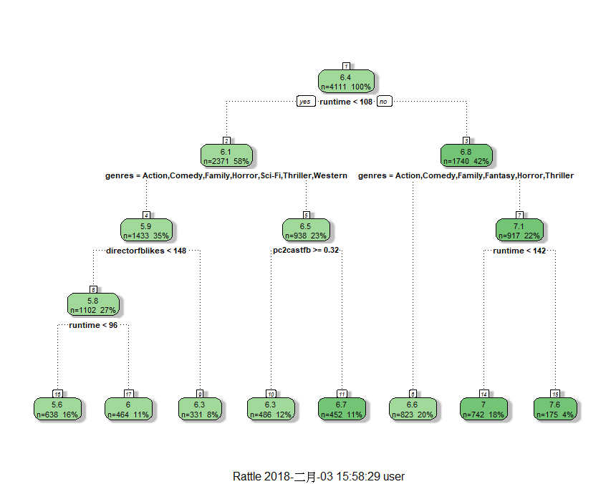
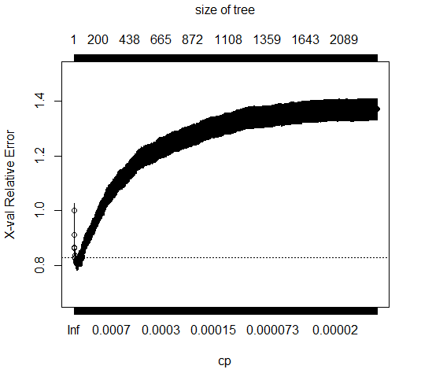
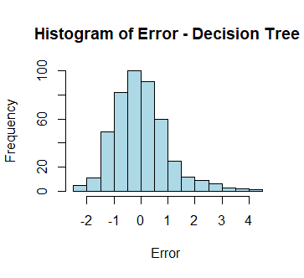
### grow tree
###Setting cp to a negative amount ensures that the tree will be fully grown.
Notice the output shows only a root node. This is because rpart has some default
parameters that prevented our tree from growing. Namely: minsplit and minbucket.
minsplit is “the minimum number of observations that must exist in a node in order
for a split to be attempted” and minbucket is “the minimum number of observations
in any terminal node”. See what happens when we override these parameters.
The complexity measure is a combination of the size of a tree and the ability of the tree
to separate the classes of the target variable. If the next best split in growing a tree
does not reduce the tree’s overall complexity by a certain amount, rpart will terminate
the growing process. This amount is specified by the complexity parameter, cp, in the call
to rpart. Setting cp to a negative amount ensures that the tree will be fully grown.
fit$cptable[which.min(fit$cptable[,"xerror"]),]
CP nsplit rel error xerror xstd
0.004723619 13.000000000 0.748361952 0.792405140 0.023354357
> fit$cptable[8,]
CP nsplit rel error xerror xstd
0.008435097 7.000000000 0.784874258 0.812566674 0.023614686
> sqrt(mean((predict(pfit,testdat)-testdat$imdbscore)^2))
[1] 1.012973
> cor(predict(pfit,testdat),testdat$imdbscore)
[1] 0.4412349
To see the cross validation results use the printcp() function.
The rel error of each iteration of the tree is the fraction of mislabeled elements
in the iteration relative to the fraction of mislabeled elements in the root.
In this example, 50% of training cases are fraudulent. The first splitting criteria is
“Is the claimant very active?”, which separates the data into a set of three cases,
all of which are fraudulent and a set of seven cases of which two are fraudulent.
Labeling the cases at this point would produce an error rate of 20% which is 40% of
the root node error rate (i.e. it’s 60% better). The cross validation error rates and
standard deviations are displayed in the columns xerror and xstd respectively.
###As a rule of thumb, it’s best to prune a decision tree using the cp of smallest
tree that is within one standard deviation of the tree with the smallest xerror.
In this example, the best xerror is 0.4 with standard deviation .25298.
So, we want the smallest tree with xerror less than 0.65298.
This is the tree with cp = 0.2, so we’ll want to prune our tree with a cp
slightly greater than than 0.2.

Slide 7
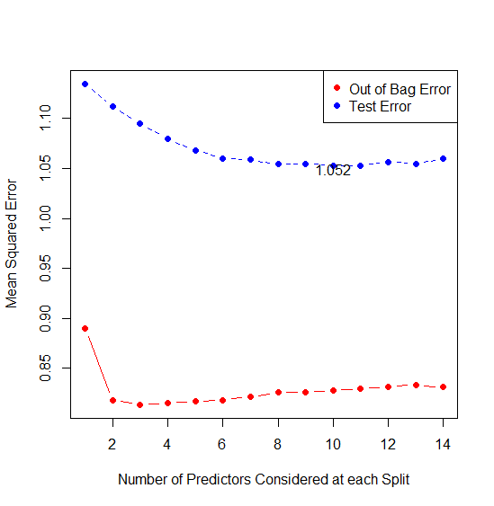
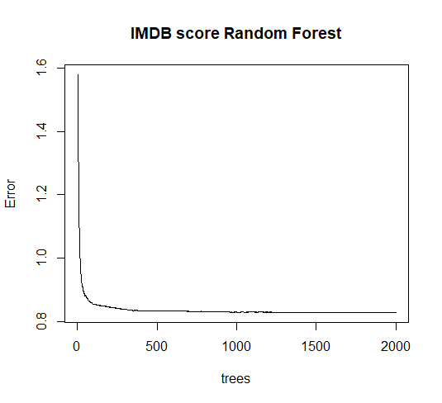
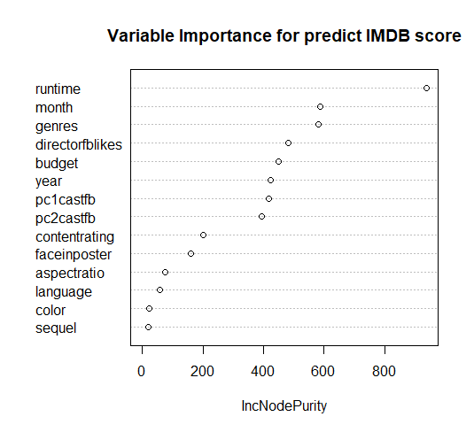
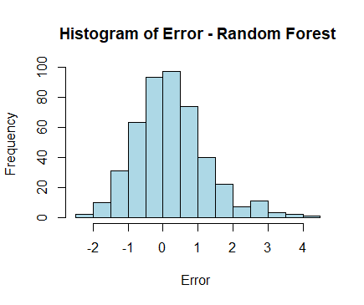
| Out-of-bag |
Tree | MSE %Var(y) |
1000 | 0.8298 68.14 |
2000 | 0.8284 68.03 |
sqrt(mean((predict(rf,testdat)-testdat$imdbscore)^2))
[1] 1.026339
> cor(predict(rf,testdat),testdat$imdbscore)
[1] 0.450483
Random Forest Setting(R package)
nodesize
Minimum size of terminal nodes. Setting this number larger causes smaller trees to be grown (and thus take less time). Note that the default values are different for classification (1) and regression (5).
maxnodes
Maximum number of terminal nodes trees in the forest can have. If not given, trees are grown to the maximum possible (subject to limits by nodesize). If set larger than maximum possible, a warning is issued.

Slide 8
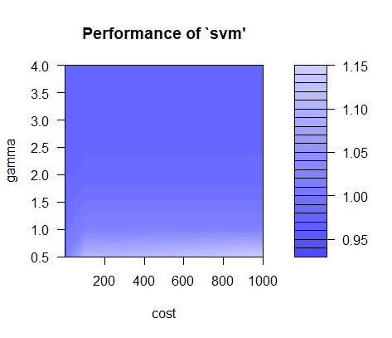
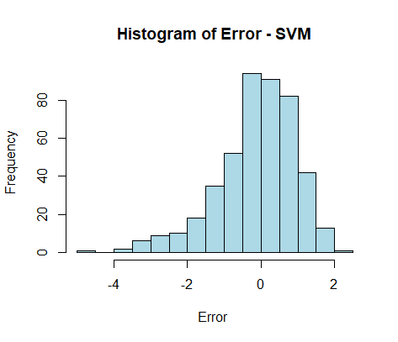
print(svm_tune)
Parameter tuning of ‘svm’:
- sampling method: 10-fold cross validation
- best parameters:
cost gamma
1 0.5
- best performance: 0.9315925
> tunedModel <- svm_tune$best.model
> tunedModel
Call:
best.tune(method = svm, train.x = imdbscore ~ ., data = svmquantrain, ranges = list(cost = 10^(-1:3),
gamma = c(0.5, 1, 2, 3, 4)), kernel = "radial")
Parameters:
SVM-Type: eps-regression
SVM-Kernel: radial
cost: 1
gamma: 0.5
epsilon: 0.1
Number of Support Vectors: 3749
> tunedModelY <- predict(tunedModel,svmquantest)
> error <- testdat$imdbscore -(1.103664*tunedModelY+6.428874)
> tunedModelRMSE <- rmse(error)
> tunedModelRMSE
[1] 1.085449
> cor((1.103664*tunedModelY+6.428874) ,testdat$imdbscore)
[1] 0.2915374

Slide 9
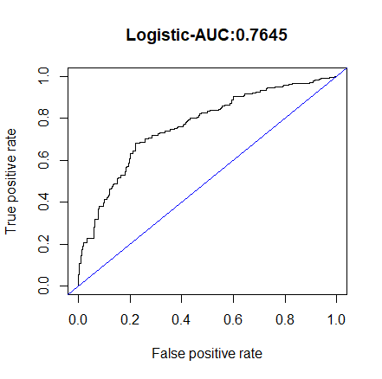
summary(backwards)
Call:
glm(formula = category ~ runtime + faceinposter + directorfblikes +
year + contentrating + color + language + aspectratio + genres +
month + pc1castfb + pc2castfb + sequel, family = binomial(link = logit),
data = train2)
Deviance Residuals:
Min 1Q Median 3Q Max
-3.1756 -0.9196 0.0517 0.9803 2.3360
Coefficients:
Estimate Std. Error z value Pr(>|z|)
(Intercept) 45.21036864 7.42779467 6.087 0.00000000115 ***
runtime 0.03176979 0.00238600 13.315 < 0.0000000000000002 ***
faceinposter -0.06113516 0.01921383 -3.182 0.00146 **
directorfblikes 0.00008918 0.00001763 5.060 0.00000041949 ***
year -0.02293025 0.00370088 -6.196 0.00000000058 ***
contentratingG -0.10895759 0.30055964 -0.363 0.71697
contentratingPG -0.47703022 0.19755016 -2.415 0.01575 *
contentratingPG-13 -0.52397435 0.18975573 -2.761 0.00576 **
contentratingR 0.00444204 0.18164388 0.024 0.98049
contentratingNC-17 -0.05655961 0.91586402 -0.062 0.95076
colorColor -0.68643875 0.22658755 -3.029 0.00245 **
languageEnglish -1.49690385 0.31214184 -4.796 0.00000162198 ***
languageFrench -0.04952861 0.48393877 -0.102 0.91848
languageGerman -1.26874756 0.76208737 -1.665 0.09595 .
languageItalian -0.47404191 0.93730675 -0.506 0.61303
languageSpanish 0.06703018 0.61131652 0.110 0.91269
languageMandarin -0.21440695 0.64739774 -0.331 0.74051
languageHindi -1.53064514 0.55781864 -2.744 0.00607 **
aspectratio1.85 -0.16051191 0.15490133 -1.036 0.30010
aspectratio2.35 -0.31290113 0.15829420 -1.977 0.04807 *
genresAction -1.39261357 0.93401448 -1.491 0.13596
genresAdventure -0.42253231 0.94050584 -0.449 0.65324
genresAnimation 0.46250277 0.99303692 0.466 0.64140
genresBiography 0.58270929 0.95345768 0.611 0.54110
genresComedy -1.08034912 0.93303006 -1.158 0.24691
genresCrime -0.62063346 0.94122472 -0.659 0.50965
genresDocumentary 1.68674573 1.00611338 1.676 0.09364 .
genresDrama -0.40193275 0.93475727 -0.430 0.66721
genresFamily -1.38597316 1.34931794 -1.027 0.30434
genresFantasy -0.62577703 0.98804569 -0.633 0.52651
genresHorror -2.04854966 0.95092069 -2.154 0.03122 *
genresMystery 0.02113511 1.03502779 0.020 0.98371
genresSci-Fi -1.21160076 1.15078648 -1.053 0.29241
genresThriller -2.50207310 1.17912639 -2.122 0.03384 *
genresWestern -1.00282390 1.19667437 -0.838 0.40203
monthFeb -0.30358108 0.18782001 -1.616 0.10602
monthMar -0.10465525 0.18003320 -0.581 0.56103
monthApr 0.02411581 0.18051417 0.134 0.89372
monthMay 0.10716062 0.18170462 0.590 0.55536
monthJun 0.21649370 0.17966559 1.205 0.22821
monthJul 0.25278159 0.18184127 1.390 0.16449
monthAug -0.26815625 0.17901027 -1.498 0.13413
monthSep 0.30812634 0.16208665 1.901 0.05730 .
monthOct 0.29218314 0.17292788 1.690 0.09110 .
monthNov 0.33700954 0.18881067 1.785 0.07428 .
monthDec 0.11996303 0.17877096 0.671 0.50219
pc1castfb 0.01147165 0.00265793 4.316 0.00001588704 ***
pc2castfb -0.00635294 0.00444013 -1.431 0.15249
sequel.L -0.70155833 0.35686212 -1.966 0.04931 *
sequel.Q 0.16794388 0.32850262 0.511 0.60918
---
Signif. codes: 0 ‘***’ 0.001 ‘**’ 0.01 ‘*’ 0.05 ‘.’ 0.1 ‘ ’ 1
(Dispersion parameter for binomial family taken to be 1)
Null deviance: 5699.0 on 4110 degrees of freedom
Residual deviance: 4625.5 on 4061 degrees of freedom
AIC: 4725.5
Number of Fisher Scoring iterations: 5
formula(backwards)
category ~ runtime + faceinposter + directorfblikes + year +
contentrating + color + language + aspectratio + genres +
month + pc1castfb + pc2castfb + sequel
table(test2$category,logistic.pred)
logistic.pred
<median >median
<median 177 62
>median 68 149
> #:accuracy:(177+149)/456
> (177+149)/456
[1] 0.7149123
> #:FP:(62)/239
> (62)/239
[1] 0.2594142
> #:FN:(68)/217
> (68)/217
[1] 0.3133641
> #:Ppred:(149)/211
> (149)/211
[1] 0.7061611
> #:Npred:(177)/245
> (177)/245
[1] 0.722449
round(exp(coef(backwards)),3)
(Intercept) runtime faceinposter
43113534282556915712.000 1.032 0.941
directorfblikes year contentratingG
1.000 0.977 0.897
contentratingPG contentratingPG-13 contentratingR
0.621 0.592 1.004
contentratingNC-17 colorColor languageEnglish
0.945 0.503 0.224
languageFrench languageGerman languageItalian
0.952 0.281 0.622
languageSpanish languageMandarin languageHindi
1.069 0.807 0.216
aspectratio1.85 aspectratio2.35 genresAction
0.852 0.731 0.248
genresAdventure genresAnimation genresBiography
0.655 1.588 1.791
genresComedy genresCrime genresDocumentary
0.339 0.538 5.402
genresDrama genresFamily genresFantasy
0.669 0.250 0.535
genresHorror genresMystery genresSci-Fi
0.129 1.021 0.298
genresThriller genresWestern monthFeb
0.082 0.367 0.738
monthMar monthApr monthMay
0.901 1.024 1.113
monthJun monthJul monthAug
1.242 1.288 0.765
monthSep monthOct monthNov
1.361 1.339 1.401
monthDec pc1castfb pc2castfb
1.127 1.012 0.994
sequel.L sequel.Q
0.496 1.183
>

Slide 10
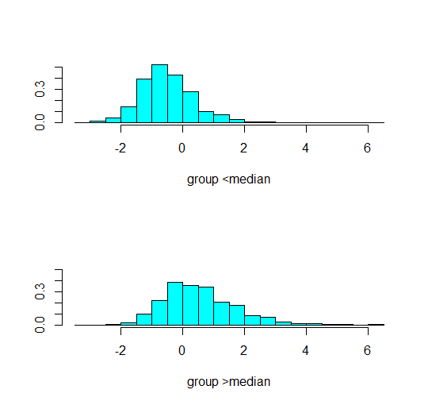
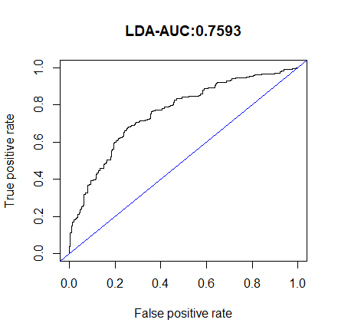
table(test2$category,lda.class2)
lda.class2
<median >median
<median 179 60
>median 72 145
> #:accuracy:(179+145)/456
> (179+145)/456
[1] 0.7105263
> #:FP:(60)/239
> (60)/239
[1] 0.251046
> #:FN:(72)/217
> (72)/217
[1] 0.3317972
> #:Ppred:(145)/205
> (145)/205
[1] 0.7073171
> #:Npred:(179)/251
> (179)/251
[1] 0.7131474
Prior probabilities of groups:
<median >median
0.4984189 0.5015811
Group means:
runtime faceinposter directorfblikes year contentratingG contentratingPG
<median 102.1035 1.532455 301.6745 2004.513 0.02000976 0.1547096
>median 114.8889 1.227449 1137.1314 2000.402 0.02473327 0.1406402
contentratingPG-13 contentratingR contentratingNC-17 colorColor languageEnglish
<median 0.3562714 0.4245974 0.0009760859 0.9824305 0.9751098
>median 0.2643065 0.4820563 0.0019398642 0.9374394 0.9151309
languageFrench languageGerman languageItalian languageSpanish languageMandarin
<median 0.004880429 0.001952172 0.0009760859 0.002440215 0.002440215
>median 0.020853540 0.005334627 0.0033947624 0.010184287 0.005819593
languageHindi aspectratio1.85 aspectratio2.35 genresAction genresAdventure
<median 0.004392387 0.4260615 0.5143973 0.2757443 0.08150317
>median 0.007759457 0.4073715 0.4932105 0.1794374 0.10135790
genresAnimation genresBiography genresComedy genresCrime genresDocumentary
<median 0.007320644 0.01610542 0.3289409 0.04978038 0.004392387
>median 0.015033948 0.08826382 0.2041707 0.08389913 0.028128031
genresDrama genresFamily genresFantasy genresHorror genresMystery genresSci-Fi
<median 0.1366520 0.0019521718 0.009760859 0.07125427 0.003904344 0.003416301
>median 0.2507274 0.0009699321 0.010669253 0.01842871 0.009699321 0.001939864
genresThriller genresWestern monthFeb monthMar monthApr monthMay
<median 0.006344558 0.001952172 0.08296730 0.09077599 0.08394339 0.07613470
>median 0.001939864 0.002909796 0.05480116 0.06547042 0.06547042 0.07807953
monthJun monthJul monthAug monthSep monthOct monthNov monthDec
<median 0.07857491 0.07369449 0.10248902 0.1078575 0.08247926 0.05563690 0.07369449
>median 0.08583899 0.07468477 0.06644035 0.1382153 0.10960233 0.07807953 0.11784675
pc1castfb pc2castfb sequel.L sequel.Q
<median 7.907221 0.3537523 -0.6753577 0.3807528
>median 9.973770 0.2765382 -0.6975049 0.3987449

Slide 11
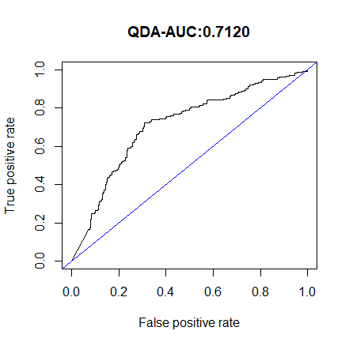
###Error in qda.default(x, grouping, ...) : rank deficiency in group low
Well, qda assumes real values (and not factors) in the explanatory
variables. If you think it makes sense to ignore this assumption (and I
doubt it makes sense), then the error message tells you there is a rank
deficiency, i.e. some variables might be collinear.
Hence at least one of the covariance matrices cannot be inverted.
Uwe Ligges
table(test2$category,qda.class2)
qda.class2
<median >median
<median 205 34
>median 130 87
> #:accuracy:(205+87)/456
> (205+87)/456
[1] 0.6403509
> #:FP:(34)/239
> (34)/239
[1] 0.1422594
> #:FN:(130)/217
> (130)/217
[1] 0.5990783
> #:Ppred:(87)/121
> (87)/121
[1] 0.7190083
> #:Npred:(205)/335
> (205)/335
[1] 0.6119403

Slide 12
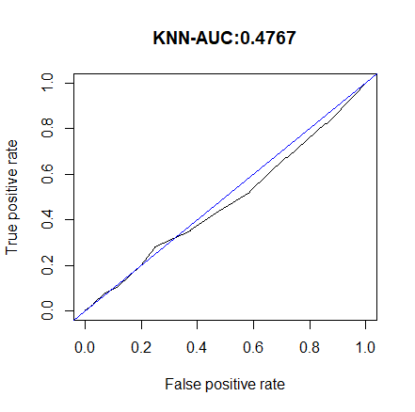
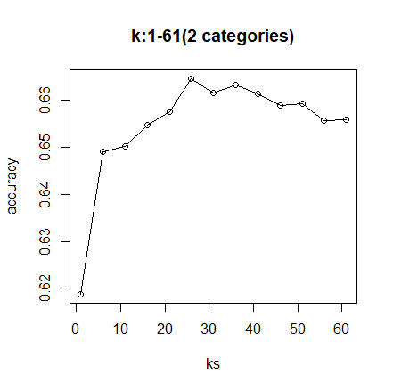
table(test2$category,pred)
pred
<median >median
<median 177 62
>median 92 125
> #:accuracy:(177+125)/456
> (177+125)/456
[1] 0.6622807
> #:FP:(62)/239
> (62)/239
[1] 0.2594142
> #:FN:(92)/217
> (92)/217
[1] 0.4239631
> #:Ppred:(125)/187
> (125)/187
[1] 0.6684492
> #:Npred:(177)/269
> (177)/269
[1] 0.6579926

Slide 13
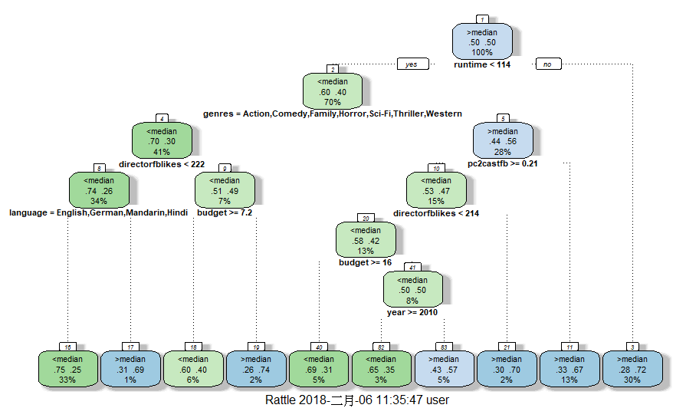
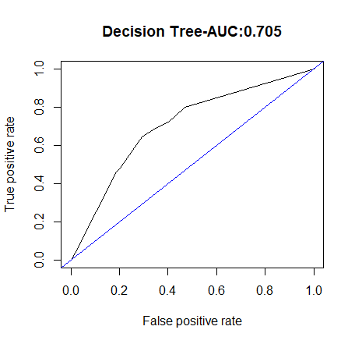
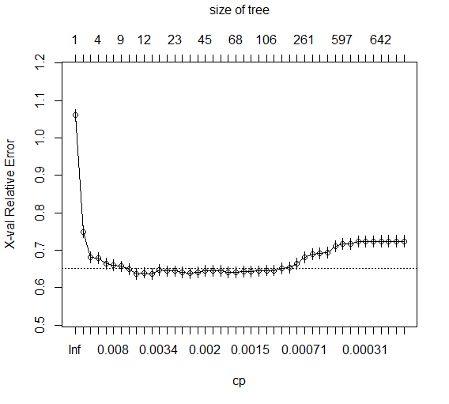
fit$cptable[which.min(fit$cptable[,"xerror"]),]
# CP nsplit rel error xerror xstd
0.004880429 10.000000000 0.582235237 0.636896047 0.014565768
#xerror:0.636896047+0.014565768=0.6514618
#choose:cp=0.00585652
fit$cptable[8,]
# CP nsplit rel error xerror xstd
0.005856515 9 0.588091752 0.649585163 0.014641842
# prune the tree
pfit<- prune(fit, cp=0.00586)
table(test2$category,pred)
pred
<median >median
<median 158 81
>median 69 148
> #:accuracy:(158+148)/456
> (158+148)/456
[1] 0.6710526
>
> #:FP:(81)/239
> (81)/239
[1] 0.3389121
>
> #:FN:(69)/217
> (69)/217
[1] 0.3179724
>
> #:Ppred:(148)/229
> (148)/229
[1] 0.6462882
>
> #:Npred:(158)/227
> (158)/227
[1] 0.6960352

Slide 14
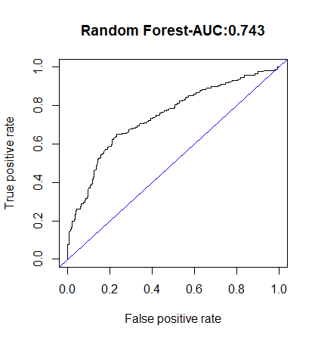
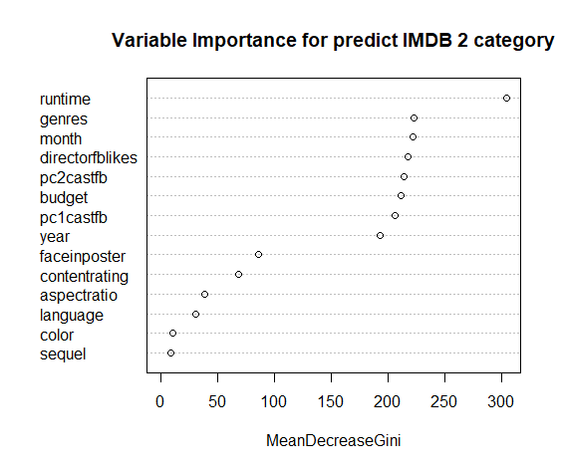
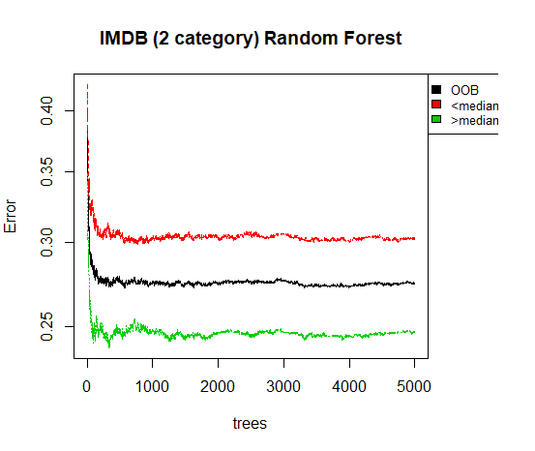
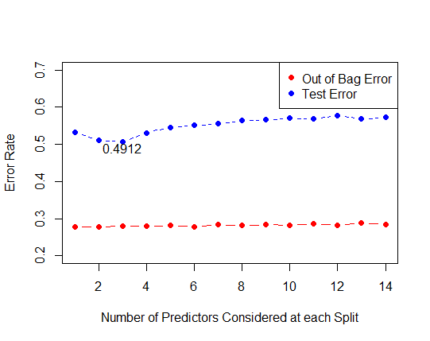
Call:
randomForest(formula = category ~ ., data = train2, importane = T, mtry = 3, do.trace = 1000, proximity = T, ntree = 5000)
Type of random forest: classification
Number of trees: 5000
No. of variables tried at each split: 3
OOB estimate of error rate: 27.44%
Confusion matrix:
<median >median class.error
<median 1429 620 0.3025866
>median 508 1554 0.2463628
> table(test2$category,pred2)
pred2
<median >median
<median 26 213
>median 7 210
> #:accuracy:(26+210)/456
> (26+210)/456
[1] 0.5175439
>
> #:FP:(213)/239
> (213)/239
[1] 0.8912134
>
> #:FN:(7)/217
> (7)/217
[1] 0.03225806
>
> #:Ppred:(210)/423
> (210)/423
[1] 0.4964539
>
> #:Npred:(26)/33
> (26)/33
[1] 0.7878788
>
> pred2<-predict(rf2,test2,type="prob")
> pred2[(pred2[,2]<0.7)]="<median"
> pred2[(pred2[,2]>0.7)]=">median"
> table(test2$category,pred2[,2])
<median >median
<median 181 58
>median 76 141
> #:accuracy:(181+141)/456
> (181+141)/456
[1] 0.7061404
> #:FP:(58)/239
> (58)/239
[1] 0.2426778
> #:FN:(76)/217
> (76)/217
[1] 0.3502304
>
> #:Ppred:(141)/199
> (141)/199
[1] 0.7085427
>
> #:Npred:(181)/257
> (181)/257
[1] 0.7042802

Slide 15
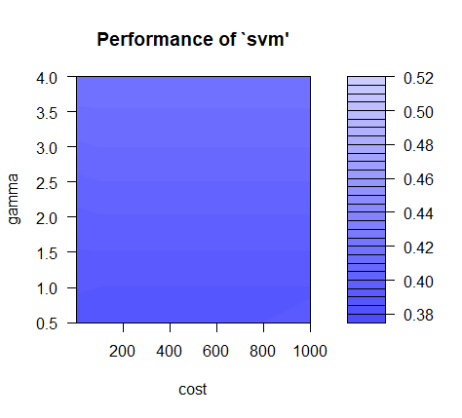
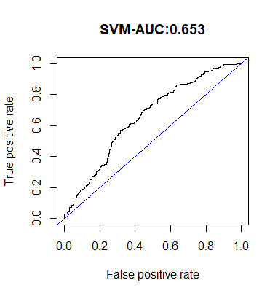
> print(svm_tunecat2)
Parameter tuning of ‘svm’:
- sampling method: 10-fold cross validation
- best parameters:
cost gamma
1 0.5
- best performance: 0.3782463
> tunedModel2 <- svm_tunecat2$best.model
> tunedModel2
Call:
best.tune(method = svm, train.x = category ~ ., data = svmqualtrain2, ranges = list(cost = 10^(-1:3),
gamma = c(0.5, 1, 2, 3, 4)), kernel = "radial")
Parameters:
SVM-Type: C-classification
SVM-Kernel: radial
cost: 1
gamma: 0.5
Number of Support Vectors: 3927
> table(svmqualtest2$category,tunedModelY2)
tunedModelY2
<median >median
<median 111 128
>median 49 168
> #:accuracy:(111+168)/456
> (111+168)/456
[1] 0.6118421
>
> #:FP:(128)/239
> (128)/239
[1] 0.5355649
>
> #:FN:(49)/217
> (49)/217
[1] 0.2258065
>
> #:Ppred:(168)/296
> (168)/296
[1] 0.5675676
>
> #:Npred:(111)/160
> (111)/160
[1] 0.69375
>
> prob <- attr (aucsvmqua, "probabilities")
> prob[(prob[,1]<0.7)]="<median"
> prob[(prob[,1]>0.7)]=">median"
> table(svmqualtest2$category,prob[,1])
<median >median
<median 234 5
>median 208 9

